Slide 1

DATA 200: DataBase management -RECAP
Christine Gurek, Lan Nguyen, Long Bui -

Slide 2
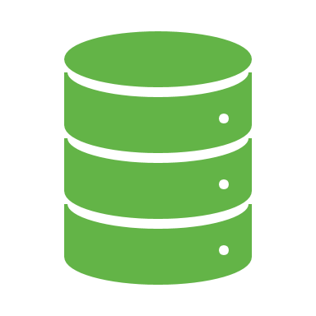
TABLE OF CONTENT
Data Systems Overview
Manipulating Data with Python
Relational Database & SQL
Hierachichal Data & Web Scrapping Technique

Slide 3

DATA SYSTEMS OVERVIEW

Slide 4
Data Systems
A system is defined as
A regularly interacting or interdependent group of items forming a unified whole.
An organization forming a network for serving a common purpose.
Data systems are defined as
Systems whose focus is on the organization and structure of data
The means of which such data can be obtained from the provider of the data by the user or client of the data.

Slide 5
Data Systems Principals
Data System Provider:
An entity, consisting of hardware, software, and possible network infrastructure, that hosts the data, provides organization, and allows access through a well-defined interface.
Data System Client:
Local software and hardware whose goal is to acquire data from one or more providers and to manage and transform the data to make it useful for analysis.
Resource Owner:
The entity that owns the resource (data, organizational resources, etc ).

Slide 6
Sources of data
API (Application Programming Interface)
allows clients to access data over the network.
Automates data access + download for client
Sometimes free, sometimes requires payment
Data may be public or may be protected
Much quicker than web-scraping if you can get what you need using an API
Web-Scraping
Writing code to “scrape” data from webpages in an automated way.
Sometimes called “crawling”
May be prohibited by the data provider (need to check terms of use)
Could provide you data that is not previously analyzed (due to barriers of accessing it)
Local Files:
files downloaded or present in the file system.
Individual files have a format that specifies the structure of the data.
Common formats include .txt , .docx , .csv , and .html .
Relational Databases:
provides data in the form of relational tables in response to queries .
Example systems include servers running Oracle, MySQL, and PostgreSQL.

Slide 7
Data forms and models
Possible Forms of Data:
Data could be organized in rows and columns in a tabular form.
Could be organized in a hierarchical tree structure, like eXtensible Markup Language (XML) or JavaScript Object Notation (JSON).
Database queries always return data organized in a relational table of rows and columns.
Our data models define the following for each form of data.
The structure used for data employing the particular model.
The operations that may be executed against data structed as given by the model.
The constraints that govern valid values for data in the model, as well as properties to be held invariant in and among the data represented in the model.
3 Main Data Models:
1. Tabular data model
2. Relational data model
3. Hierarchical data model

Slide 8

Python packages for data management

Slide 9
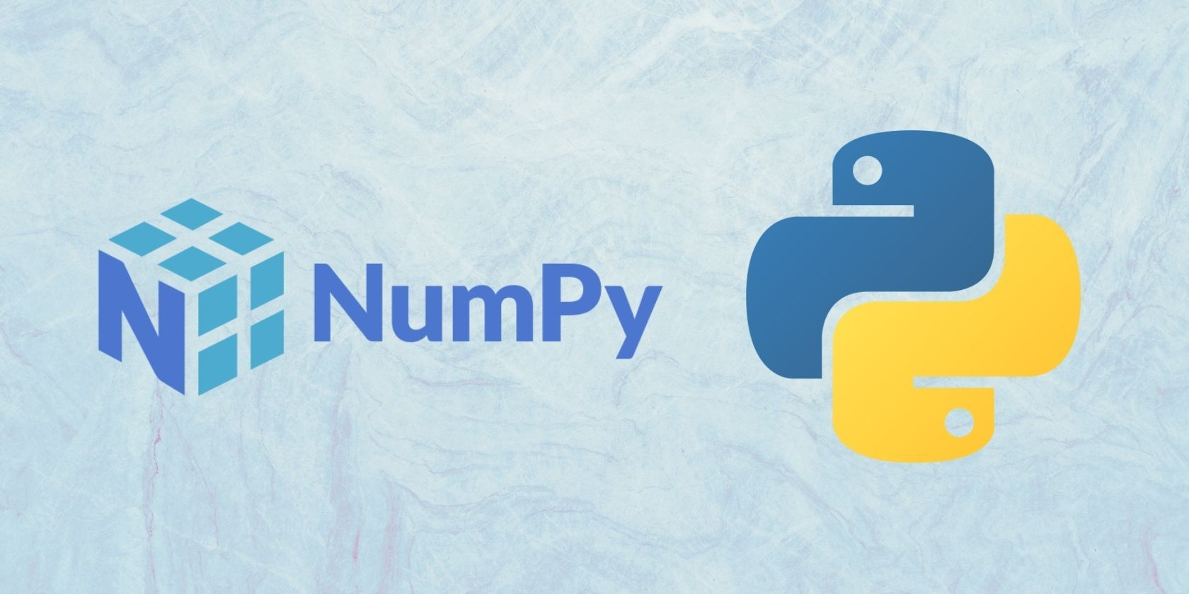
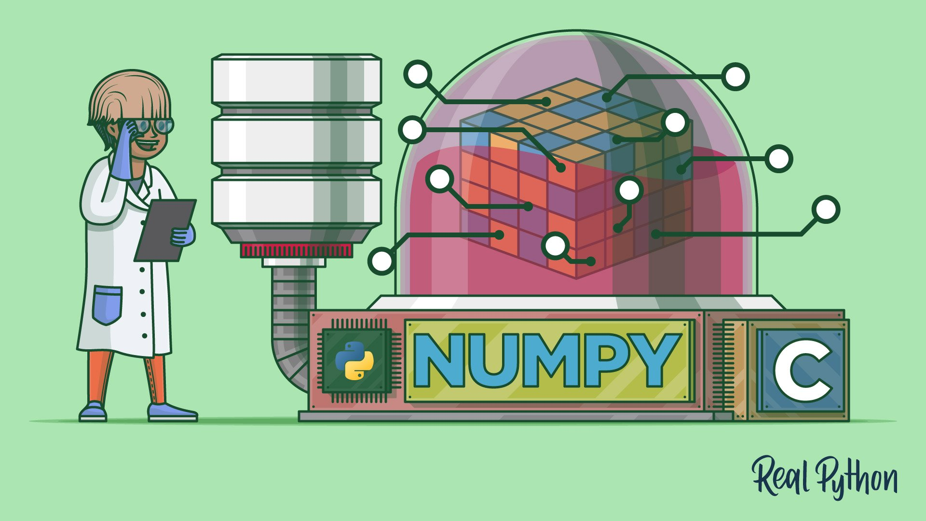
Numpy
- Acronym for "Numerical python".
- a Python package for high performance computing and data analysis created in 2005.
- NumPy works with n-th dimensional arrays, aim to provide an array object that is up to 50x faster than a traditional list.

Slide 10
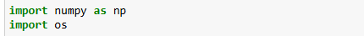
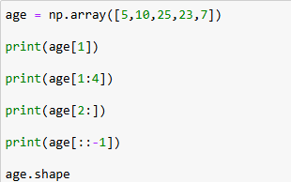
Technical side
- NumPy package is not part of the standard Python, so you need to install and import it.
- To use numpy, the common coding form would be "np.function"

Slide 11
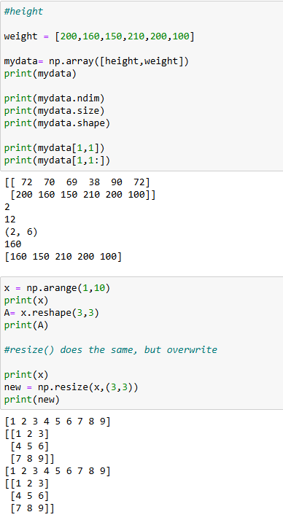
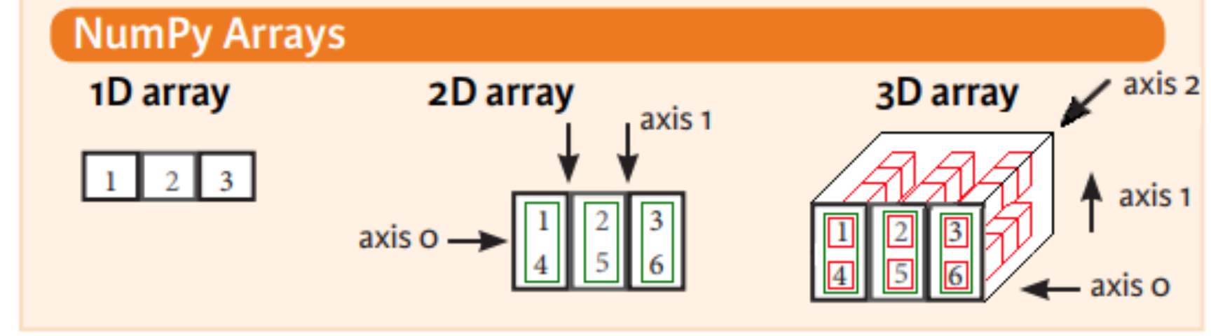
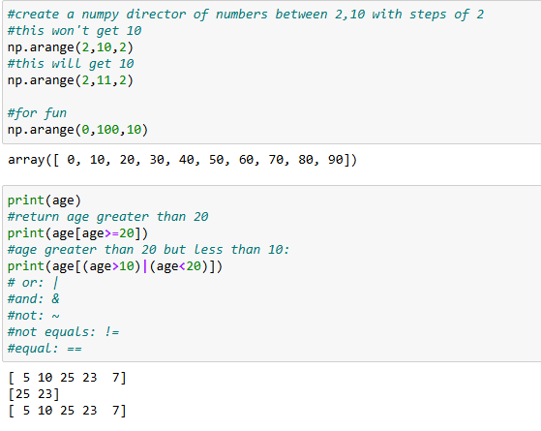
Technical side
Things can be done with numpy function:
+adding, removing, and sorting elements
+tell the shape and size of an array
+reshape an array
+index and slicing
+maximum, minimum, sum, mean, etc.
+math and trigonometric function

Slide 12

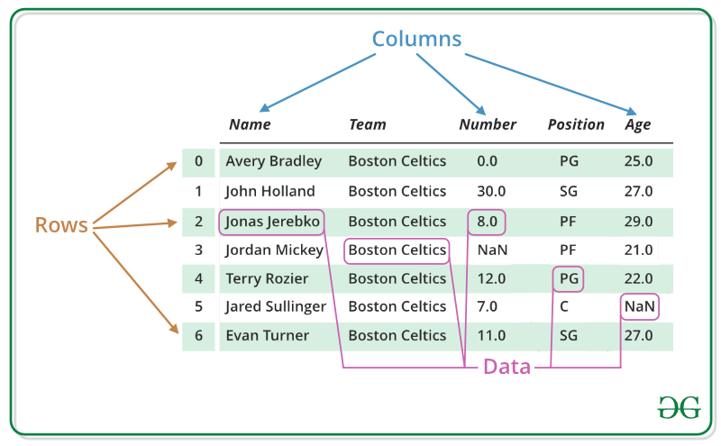
Pandas
- An open-source Python library for data analysis, created in 2008
- The name "Pandas" has a reference to both "Panel Data", and "Python Data Analysis"
ThePhoto by PhotoAuthor is licensed under CCYYSA.
Why Use Pandas?
Pandas allows us to analyze big data and make conclusions based on statistical theories.
Pandas can clean messy data sets, and make them readable and relevant.
Relevant data is very important in data science.

Slide 13
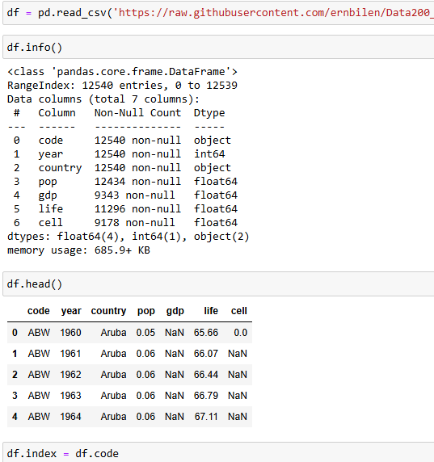
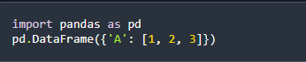
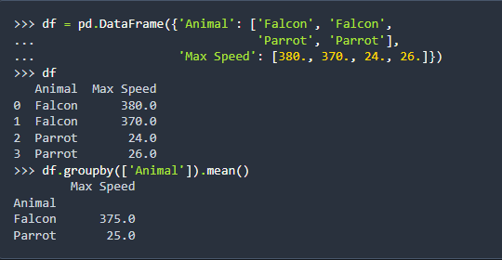
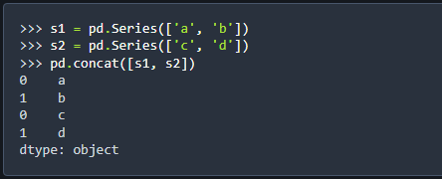
Functions
Dataframe functions:
- create dataframe
- Read CSV, JSON file
- Analyzing data
Data related technique:
-- Data manipulation
-- Cleaning data
-- Cleaning Empty cells
-- Cleaning Wrong format/data
-- Remove duplicate

Slide 14

Relational database

Slide 15
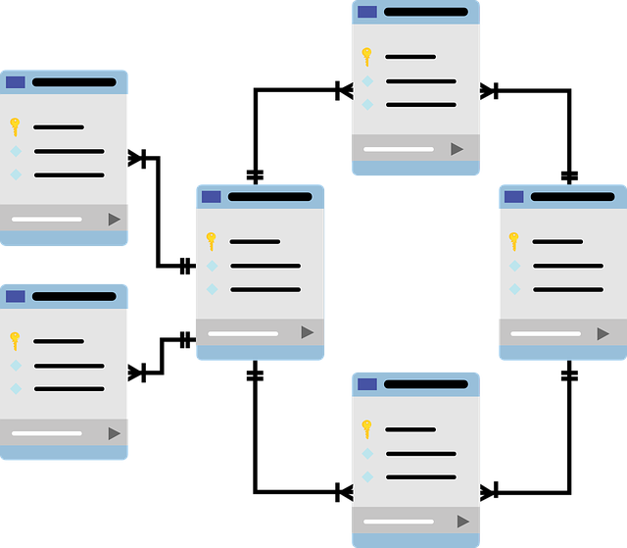
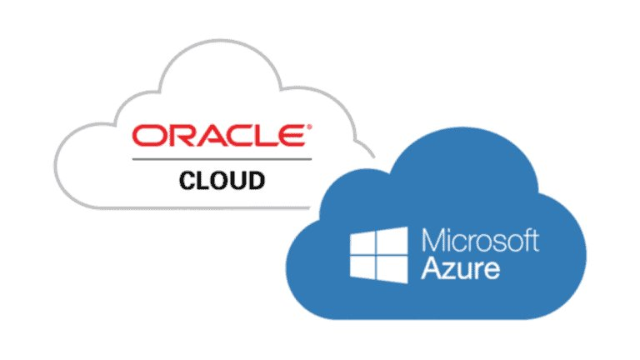
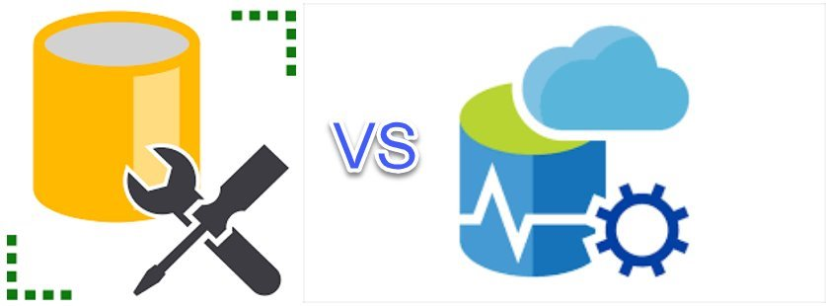
Relational Database is a type of database that stores and provides access to data points that are related to one another. (most common).
A DATABASE MANAGEMENT SYSTEM (DBMS) IS SOFTWARE FOR MANAGING DATABASES AND PROVIDING ACCESS TO THEM. (CREATE, READ, ADD, UPDATE)
Notes:
In the relational database model, the structure consists of multiple, inter-dependent tables
each table is comprised of rows and columns, just like in tabular model.
Tables are the main structures in a database, each table represents a single, specific subject.
Every table contains at least one column—known as the primary key—that uniquely identifies each of its rows.

Slide 16
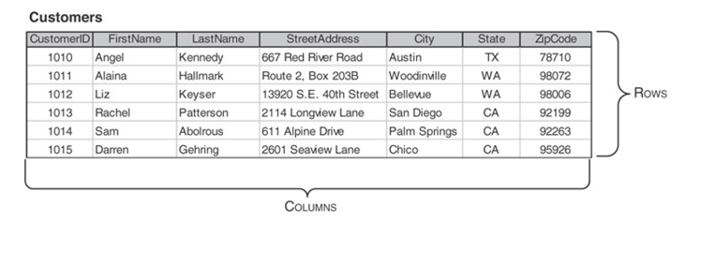
ROWS & COLUMNS
Notes:
A column represents a characteristic of the subject of the table to which is belongs.
In the relational model, columns of a table are also called fields.
A row represents a unique instance of a subject in the table.
Rows are often called records.
Each row is identified throughout the database by a unique value in the primary key column(s) of that row.

Slide 17
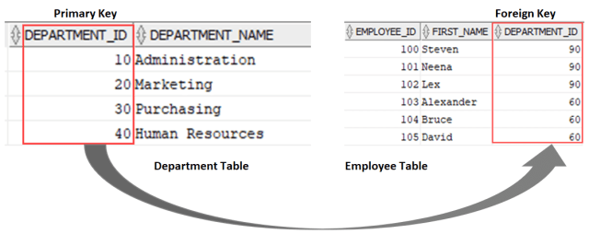

Slide 18
RELATIONAL DATABASE
Functional Depencies: a relationship between two sets of attributes in a relation/table, where the value of one set of attributes determines the value of another attribute. (X --> Y)
Ex: courseid ➡ coursesubject, coursenum, coursetitle, coursehours
Its Importance:
+ Determines primary key for a table
+ Normalizing data table
+ Identify Relationships between different tabale: one-to-one, many-to-many, one-to-many

Slide 19
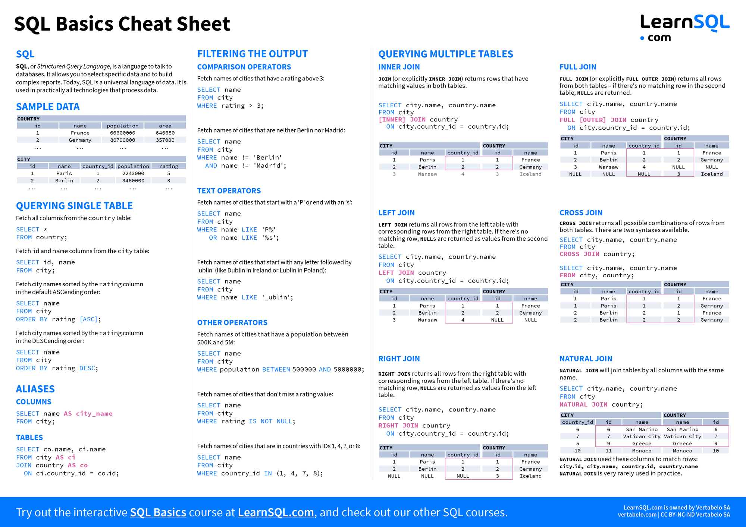
SQL is a standard language for managing and manipulating relational databases. Here's a summary of key aspects of SQL SQL allows users to:
Query data from databases
Insert, update, and delete records
Create and modify database structures
Set permissions on database objects
.

Slide 20
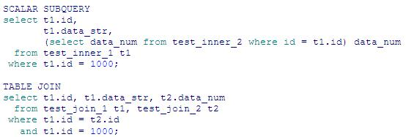
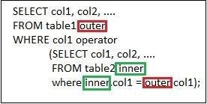
Subqueries
Notes:
A subquery in SQL is a query nested inside another query.
Scalar subqueries return a single value (one row, one column) and can be used anywhere an expression is allowed, such as in SELECT or WHERE clauses. They are executed once for the entire outer query.
Correlated subqueries reference columns from the outer query and are executed once for each row processed by the outer query. They can return single or multiple values. For example:

Slide 21
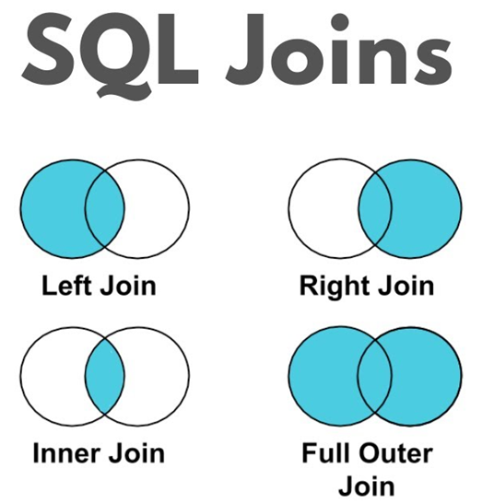

Slide 22

Sql alchemy
SQLAlchemy is a powerful and flexible Python SQL toolkit and Object Relational Mapper (ORM) that provides developers with the full capabilities of SQL

Slide 23

WEB-SCRAPPING& HIERARICHAL data

Slide 24
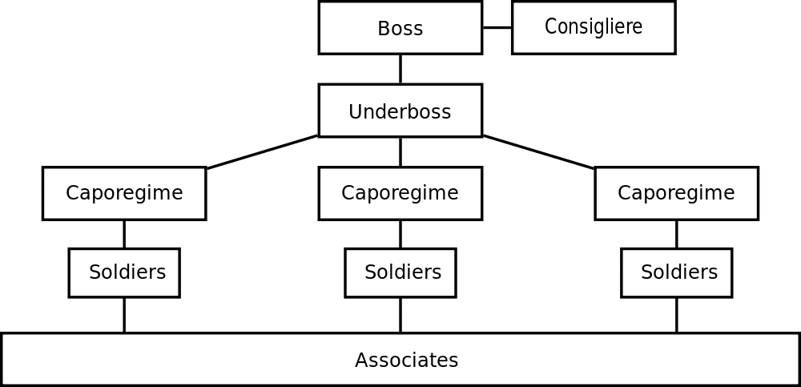
HIERARICHAL DATA
Hierarchical Database Models
Structure: Tree-like organization with parent-child relationships
Simplicity: Easy to understand and navigate
Key Applications
Operating Systems: File and folder structures
Websites: Drop-down menus and navigation
Data Formats: JSON, XML, HTML
Advantages
Fast data traversal and retrieval
Efficient for one-to-many relationships
Easy addition/deletion of data
Web Data and APIs
Natural fit for hierarchical data from web scraping and APIs
XPath for XML/HTML parsing
Selenium for dynamic web scraping
Limitations
Less flexible for complex relationships
Struggles with many-to-many relationships
Notes:
Logistics: Hierarchical database models are simpler, and are more suitable for OS or websites.
The one-to-many organization of data makes traversing the database simple and fast, which is ideal for use cases such as website drop-down menus or folder structures of an operating system.
Information can easily be added or deleted without affecting the entirety of the database.
Data obtained from web scraping and from APIs are naturally hierarchical.
We will cover the most widely used formats: JSON, XML, and HTML then learn about how to scrape using the Selenium library.
Json, xml, xpath

Slide 25
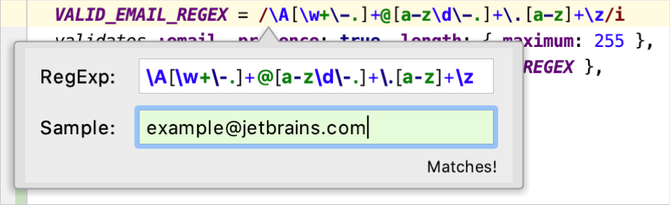
regex
Regular Expressions (RegEx)
Definition: Powerful pattern-matching sequences for text searching and manipulation
Key Components
Literal Characters: Exact text to match
Metacharacters: Special symbols (e.g., ., *, +, ?, [ ], ^, $)
Quantifiers: Specify repetition (e.g., *, +, ?, {n}, {n,m})
Character Classes: Define sets of characters (e.g., [a-z], [0-9])
Anchors: Match positions (^ for start, $ for end)
Common Applications
Input validation (e.g., email, password)
Text search and replace
Data extraction and formatting
Web scraping
Log file analysis
Notes:
Logistics: Hierarchical database models are simpler, and are more suitable for OS or websites.
The one-to-many organization of data makes traversing the database simple and fast, which is ideal for use cases such as website drop-down menus or folder structures of an operating system.
Information can easily be added or deleted without affecting the entirety of the database.
Data obtained from web scraping and from APIs are naturally hierarchical.
We will cover the most widely used formats: JSON, XML, and HTML then learn about how to scrape using the Selenium library.
Json, xml, xpath

Slide 26
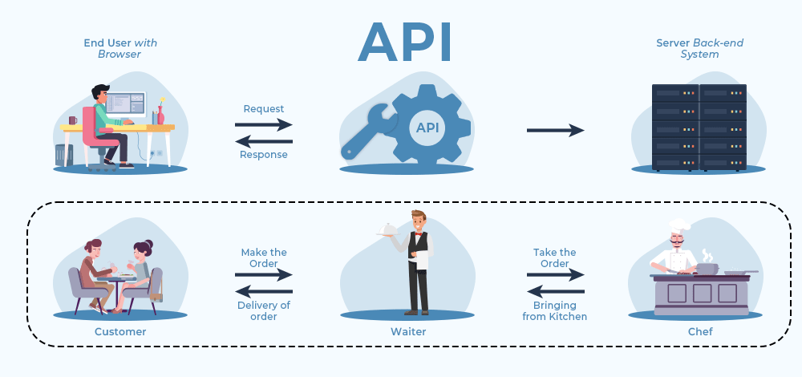
API
What is an API?
Definition: An API is a set of protocols that allows different software applications to communicate with each other, enabling data exchange and functionality sharing .
Analogy: Think of an API as a waiter in a restaurant who takes your order (request), communicates with the kitchen (service), and brings back your food (response) .
How APIs Work
Request: A client application sends a request to the API endpoint.
Processing: The API processes the request and interacts with the server or database.
Response: The API sends back the requested data or confirmation of action taken

Slide 27
SELENIUM WEB SCRAPPING
Automate interactions with web pages, like clicking buttons and filling forms
Handle dynamic content loaded by JavaScript
Scrape data from complex, JavaScript-heavy websites

Slide 28
Setting Up Selenium
Install the Selenium package: pip install selenium
Install a WebDriver for your browser (e.g. ChromeDriver for Chrome)
Import Selenium modules in your Python script

Slide 29
Basic Scraping Steps
Create a WebDriver instance
Navigate to the target URL
Locate elements using locators
Extract data from elements
Process and store the scraped data

Slide 30
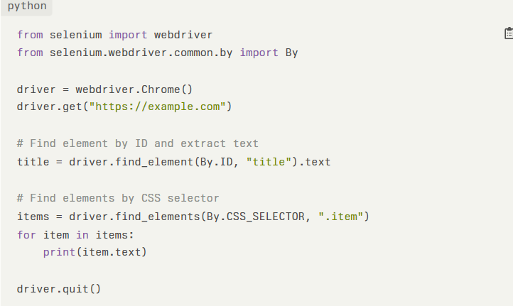

Slide 31

THANK YOU FOR LISTENNING TO OUR PRESENTATION

